Slide 1

Community Event Management System
Theme- SDG Goal 11- Sustainable Cities & Communities
Category- Software
Group No -10
Group Members - 1. Harshita Waghmare
2. Jagruti Singh
3. Riya Singh
Guide- Prof. Darshana Bhamare

Slide 2
Outline
Introduction
Literature Survey
Limitations of existing systems
Problem statement and Objectives
Proposed Methodology
Experimental Setup
Implementation
Results & Analysis
Conclusion and Future work
References

Slide 3
Introduction
Background & Importance
Communities struggle with event organization.
Manual systems → poor participation, wasted resources.
Importance: Digital solution improves efficiency, engagement, sustainability.
Current Challenges & Motivation
Challenges: Manual registration, no volunteer tracking, limited communication.
Motivation: Inspired by SDG Goal 11 to strengthen community participation.
Aim: Use technology to empower communities.

Slide 4
Problem statement and Objectives
Problem Statement
Communities lack a unified platform to manage events, volunteers, and participants effectively.
Objectives
Role‑based dashboards (Admin, Volunteer, Participant).
Design relational database schema with integrity constraints.
Dashboard metrics for organizers. (event status, volunteer stats)
Analytics & performance reports for event success tracking.
Alignment with SDG Goal 11 to promote sustainable community engagement.

Slide 5
Literature Survey
Existing Solutions
Eventbrite → Large‑scale event hosting, ticketing.
Meetup → Community group creation, event scheduling.
Google Forms → Simple event registration.
Local community apps → Basic CRUD operations.
Techniques Used
CRUD web apps, APIs, cloud hosting.
Simple dashboards for event creation.
Registration forms with limited customization.
Focused mainly on participants, not volunteers.

Slide 6
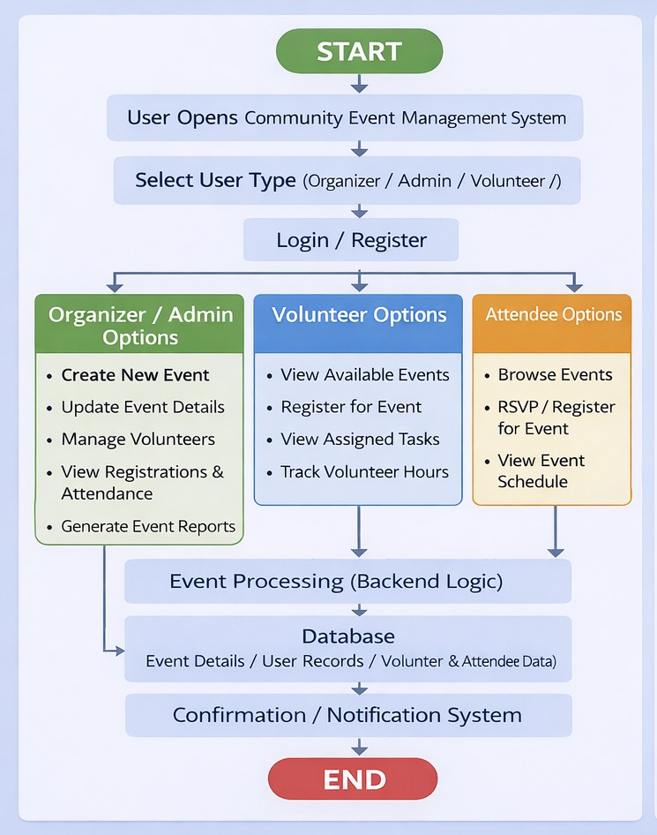
Proposed Methodology

Slide 7
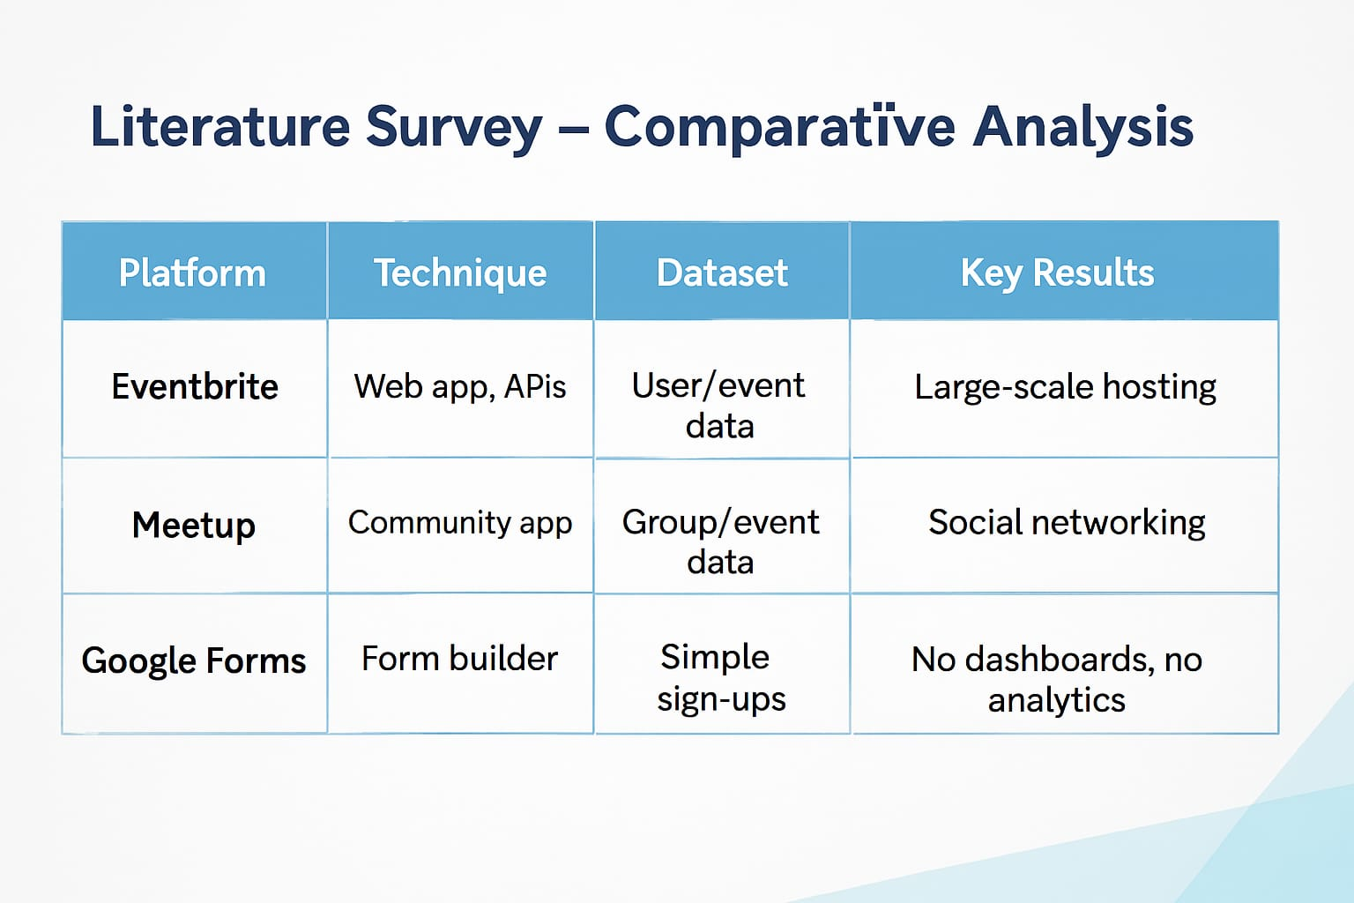
Literature Survey
Comparative Analysis

Slide 8
Limitations of existing Systems
No volunteer management.
No skill‑based task suggestion.
No dashboard metrics for organizers.
No analytics/reports for event performance.
No budget & expense tracking

Slide 9
Proposed Methodology
Techstack:
1.Frontend (HTML+CSS) → User sees and interacts
2.Flask Routes (Python) → Processes requests
3.Database Helper (models/db.py) → Connects to MySQL
4.MySQL→ Stores and retrieves data
5.Jinja2 Templates → Injects Python data into HTML
6.Bootstrap → Makes it look professional

Slide 10
Experimental Setup
Input/Dataset: Event details, volunteer registrations, participant entries.
Performance Parameters: Response time, task assignment accuracy, user satisfaction.
Software/Hardware: Flask server, MySQL DB, Bootstrap frontend.

Slide 11
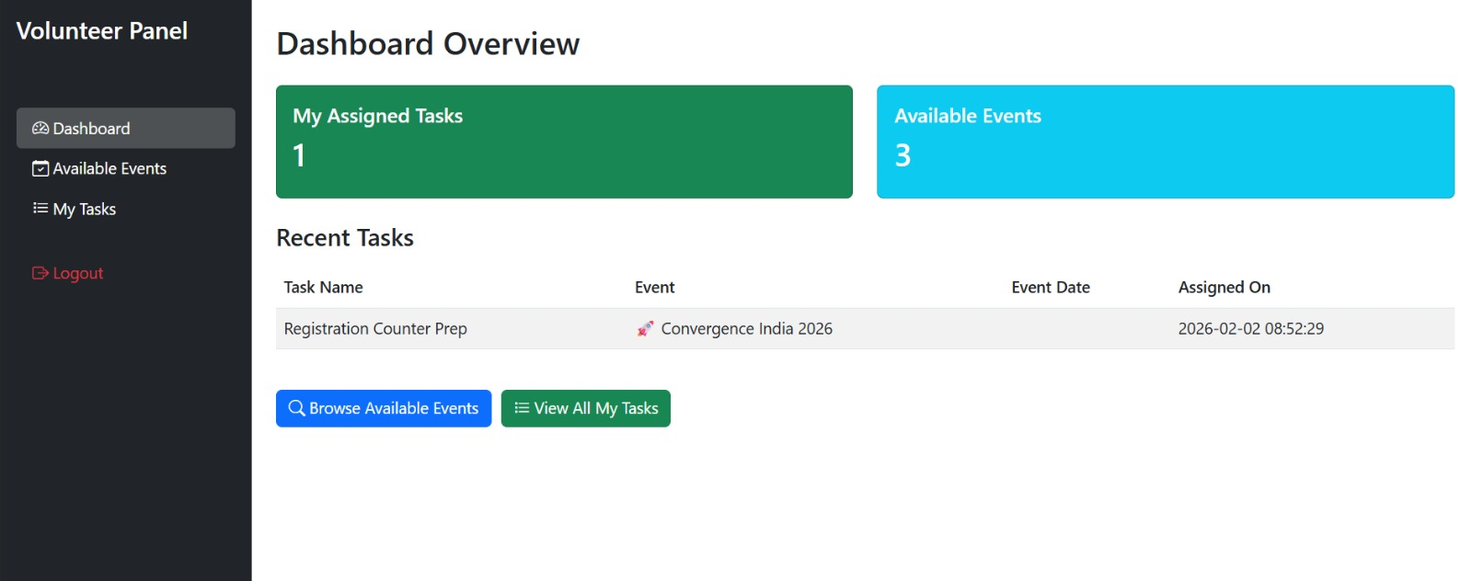
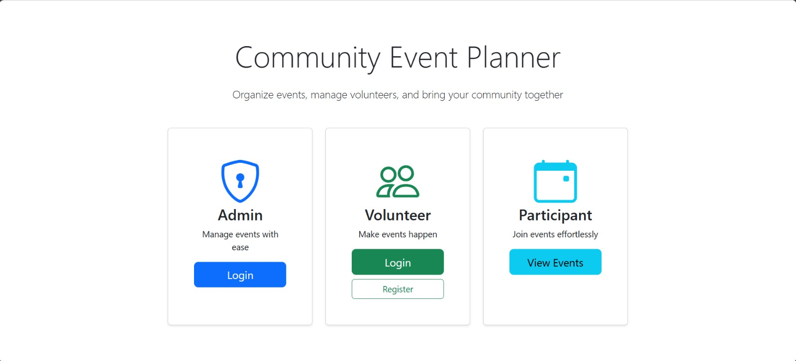
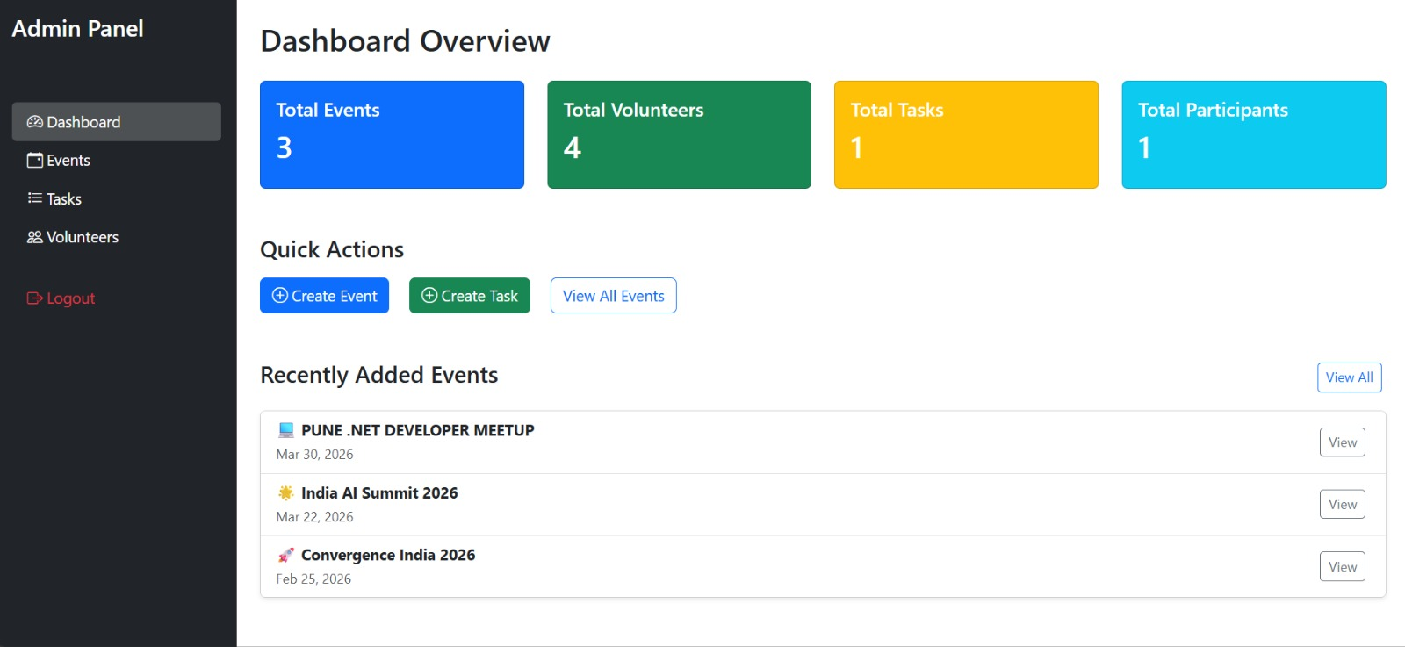
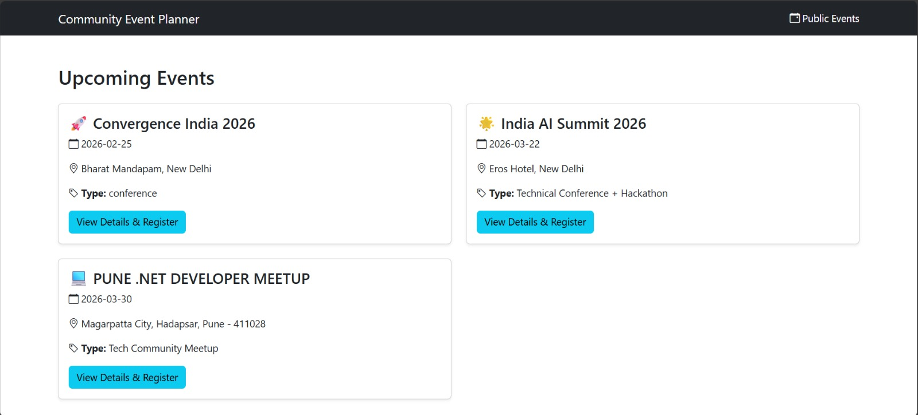
Implementation

Slide 12
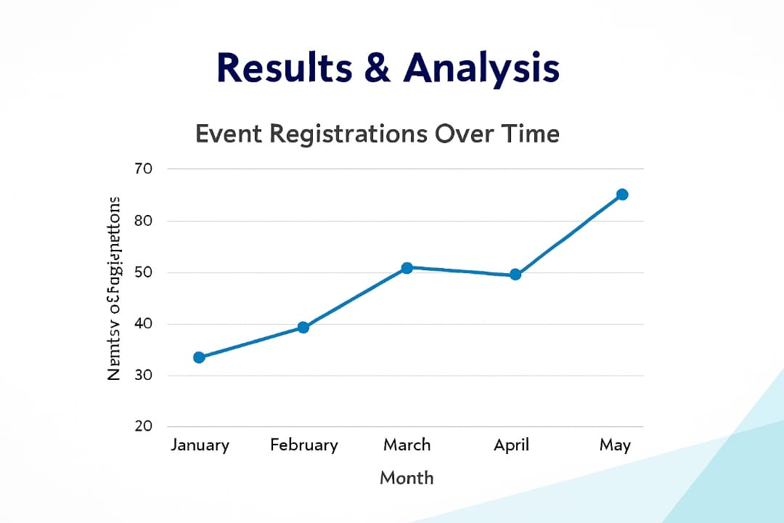
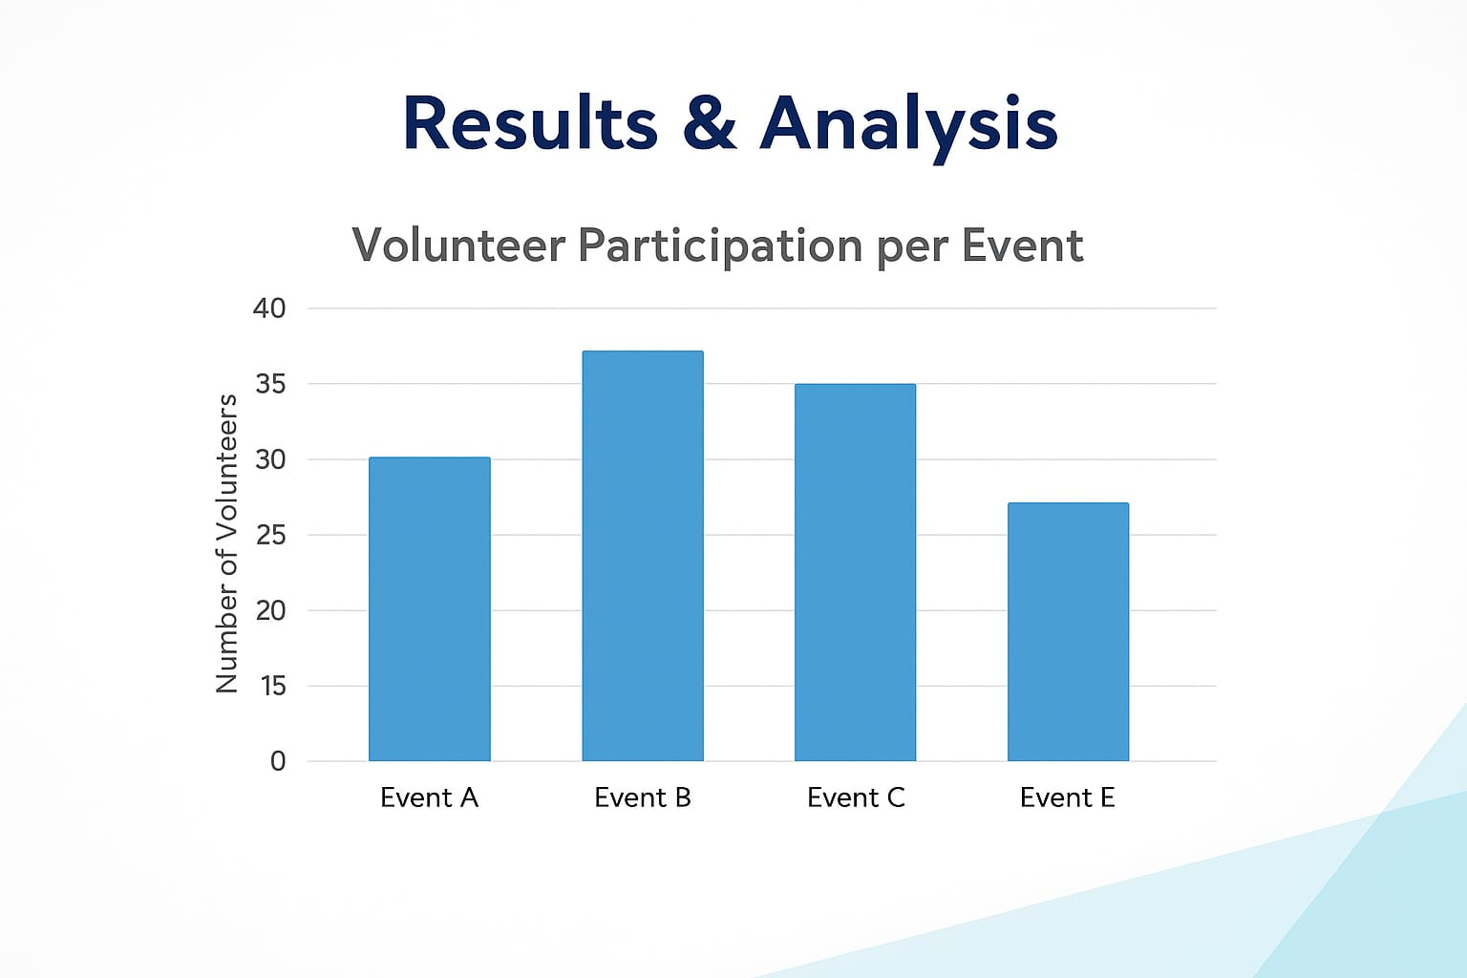
Results & Analysis
Metrics:
Accuracy, response time, user feedback.

Slide 13
Conclusion and Future work
Objective 1: Centralized system
→ Achieved through integrated Flask modules and MySQL database
Objective 2: Prevent duplicates
→ Achieved using validation logic + database constraints
Objective 3: Volunteer integration
→ Achieved through volunteer assignment module
Objective 4: Capacity tracking
→ Achieved through real-time seat validation before registration
Scope of improvement
Skill-Based Task Suggestion
Dashboard Metrics
Analytics / Reports
Budget & Expense Tracking

Slide 14
References
Y. Wang et al., "Web Database Connectivity Methods (using MySQL)," in Proc. ICTTA, 2006, doi: 10.1109/ICTTA.2006.1684995.
S. Rathore et al., "Web Application Security Testing Framework using Flask," in Proc. ICCSPA, 2023, doi: 10.1109/ICCSPA56550.2023.10140422.
C.-H. Chen et al., "Python-based data mining and analysis," in Proc. ICASIC, 2022, doi: 10.1109/ICASIC56540.2022.9948378.
M. A. Al-Ghamdi, "Generating SQL Command Syntax Using MySQL," Informatics, vol. 6, no. 1, 2021, doi: 10.25139/inform.v6i1.3305

Slide 15
Thank You...!!

